Slide 1
The Evolution of a Sparse Partial Pivoting
Algorithm
John R. Gilbert
with:
Tim Davis, Jim Demmel, Stan Eisenstat, Laura Grigori, Stefan Larimore, Sherry Li, Joseph Liu, Esmond Ng, Tim Peierls, Barry Peyton, . . .

Slide 2
Outline
Introduction:
  A modular approach to left-looking LU
Combinatorial tools:
  Directed graphs (expose path structure)
  Column intersection graph (exploit symmetric theory)
LU algorithms:
  From depth-first search to supernodes
Column ordering:
  Column approximate minimum degree
  Open questions

Slide 3
The Problem
P
=
x
PA = LU
Sparse, nonsymmetric A
Columns may be preordered for sparsity
Rows permuted by partial pivoting
High-performance machines with memory hierarchy

Slide 4
Symmetric Positive Definite: A=R^{T}R [Parter, Rose]
symmetric
for j = 1 to n
add edges between j’s
higher-numbered neighbors
1
3
7
1
3
7
8
6
8
6
4
10
4
10
fill = # edges in G⁺
9
5
2
9
5
2
G(A)
G⁺(A)
[chordal]

Slide 5
Symmetric Positive Definite: A=R^{T}R
Preorder
  Independent of numerics
Symbolic Factorization
  Elimination tree
  Nonzero counts
  Supernodes
  Nonzero structure of R
Numeric Factorization
  Static data structure
  Supernodes use BLAS3 to reduce memory traffic
Triangular Solves
}
O(#nonzeros in A), almost
O(#nonzeros in R)
O(#flops)
Result:
  Modular => Flexible
  Sparse ~ Dense in terms of time/flop

Slide 6
Modular Left-looking LU
Alternatives:
  Right-looking Markowitz [Duff, Reid, . . .]
  Unsymmetric multifrontal [Davis, . . .]
  Symmetric-pattern methods [Amestoy, Duff, . . .]
Complications:
  Pivoting => Interleave symbolic and numeric phases
    Preorder Columns
    Symbolic Analysis
    Numeric and Symbolic Factorization
    Triangular Solves
  Lack of symmetry => Lots of issues . . .

Slide 7
Symmetric A implies G⁺(A) is chordal,
with lots of structure and elegant theory
For unsymmetric A, things are not as nice
No known way to compute G⁺(A) faster than
Gaussian elimination
No fast way to recognize perfect elimination graphs
No theory of approximately optimal orderings
Directed analogs of elimination tree:
Smaller graphs that preserve path structure
[Eisenstat, G, Kleitman, Liu, Rose, Tarjan]

Slide 8
Outline
Introduction:
  A modular approach to left-looking LU
Combinatorial tools:
  Directed graphs (expose path structure)
  Column intersection graph (exploit symmetric theory)
LU algorithms:
  From depth-first search to supernodes
Column ordering:
  Column approximate minimum degree
  Open questions

Slide 9
Directed Graph
1
2
4
7
5
3
6
A
G(A)
A is square, unsymmetric, nonzero diagonal
Edges from rows to columns
Symmetric permutations PAP^{T}

Slide 10
Symbolic Gaussian Elimination [Rose, Tarjan]
1
2
4
7
5
3
6
A
+
L+U
G (A)
Add fill edge a -> b if there is a path from a to b through lower-numbered vertices.

Slide 11
Structure Prediction for Sparse Solve
1
2
=
4
7
5
3
6
A
x
b
G(A)
Given the nonzero structure of b, what is the structure of x?
Vertices of G(A) from which there is a path to a vertex of b.

Slide 12
Column Intersection Graph
1
2
3
4
5
1
2
3
4
5
3
1
2
4
5
3
4
5
1
2
A
A^{T}A
G∩(A)
G∩(A) = G(A^{T}A) if no cancellation (otherwise ⊇)
Permuting the rows of A does not change G∩(A)

Slide 13
Filled Column Intersection Graph
1
2
3
4
5
1
2
3
4
5
3
1
2
4
5
3
4
5
1
2
A
chol(A^{T}A)
+
G∩(A)
G∩(A) = symbolic Cholesky factor of A^{T}A
In PA=LU, G(U) ⊆ G∩(A) and G(L) ⊆ G∩(A)
Tighter bound on L from symbolic QR
Bounds are best possible if A is strong Hall
[George, G, Ng, Peyton]
+
+
+

Slide 14
Column Elimination Tree
5
1
2
3
4
5
1
2
3
4
5
1
4
2
3
2
3
4
5
1
A
chol(A^{T}A)
T∩(A)
Elimination tree of A^{T}A (if no cancellation)
Depth-first spanning tree of G∩(A)
Represents column dependencies in various factorizations
+

Slide 15
Column Dependencies in PA = LU
If column j modifies column k, then j ∈ T∩[k]. [George, Liu, Ng]
k
j
T∩[k]
If A is strong Hall then, for some pivot sequence, every column modifies its parent in T∩(A). [G, Grigori]

Slide 16
Efficient Structure Prediction
Given the structure of (unsymmetric) A, one can find . . .
  column elimination tree T∩(A)
  row and column counts for G∩(A)
  supernodes of G∩(A)
  nonzero structure of G∩(A)
. . . without forming G∩(A) or A^{T}A
[G, Li, Liu, Ng, Peyton; Matlab]
+
+
+

Slide 17
Outline
Introduction:
  A modular approach to left-looking LU
Combinatorial tools:
  Directed graphs (expose path structure)
  Column intersection graph (exploit symmetric theory)
LU algorithms:
  From depth-first search to supernodes
Column ordering:
  Column approximate minimum degree
  Open questions

Slide 18
Left-looking Column LU Factorization
j
for column j = 1 to n do
  solve
  pivot: swap u_{jj} and an elt of l_{j}
  scale: l_{j} = l_{j} / u_{jj}
U
( )
( )
L 0
L I
u_{j}
l_{j}
L
= a_{j} for u_{j}, l_{j}
A
L
Column j of A becomes column j of L and U

Slide 19
Sparse Triangular Solve
1
1
2
3
4
5
=
2
3
5
4
L
x
b
G(L^{T})
Symbolic:
  Predict structure of x by depth-first search from nonzeros of b
Numeric:
  Compute values of x in topological order
Time = O(flops)

Slide 20
GP Algorithm [G, Peierls; Matlab 4]
Left-looking column-by-column factorization
Depth-first search to predict structure of each column
+: Symbolic cost proportional to flops
-: BLAS-1 speed, poor cache reuse
-: Symbolic computation still expensive
=> Prune symbolic representation

Slide 21
Symmetric Pruning [Eisenstat, Liu]
Idea: Depth-first search in a sparser graph with the same path structure
r
j
k
Symmetric pruning:
Set L_{sr}=0 if L_{jr}U_{rj} ≠ 0
Justification:
A_{sk} will still fill in
r
= fill
j
= pruned
= nonzero
s
Use (just-finished) column j of L to prune earlier columns
No column is pruned more than once
The pruned graph is the elimination tree if A is symmetric

Slide 22
GP-Mod Algorithm [Eisenstat, Liu; Matlab 5]
Left-looking column-by-column factorization
Depth-first search to predict structure of each column
Symmetric pruning to reduce symbolic cost
+: Much cheaper symbolic factorization than GP (~4x)
-: Still BLAS-1
=> Supernodes

Slide 23
Symmetric Supernodes [Ashcraft, Grimes, Lewis, Peyton, Simon]
Supernode = group of (contiguous) factor columns with nested structures
Related to clique structure
of filled graph G⁺(A)
{
Supernode-column update: k sparse vector ops become
1 dense triangular solve
+ 1 dense matrix * vector
+ 1 sparse vector add
Sparse BLAS 1 => Dense BLAS 2

Slide 24
Nonsymmetric Supernodes
1
1
2
2
3
3
4
4
5
5
6
6
7
7
8
8
9
9
10
10
Original matrix A
Factors L+U

Slide 25
Supernode-Panel Updates
j
j+w-1
for each panel do
  Symbolic factorization:
  which supernodes update the panel;
  Supernode-panel update:
  for each updating supernode do
    for each panel column do
    supernode-column update;
  Factorization within panel:
  use supernode-column algorithm
}
}
supernode
panel
+: “BLAS-2.5” replaces BLAS-1
-: Very big supernodes don’t fit in cache
=> 2D blocking of supernode-column updates

Slide 26
Sequential SuperLU [Demmel, Eisenstat, G, Li, Liu]
Depth-first search, symmetric pruning
Supernode-panel updates
1D or 2D blocking chosen per supernode
Blocking parameters can be tuned to cache architecture
Condition estimation, iterative refinement, componentwise error bounds

Slide 27
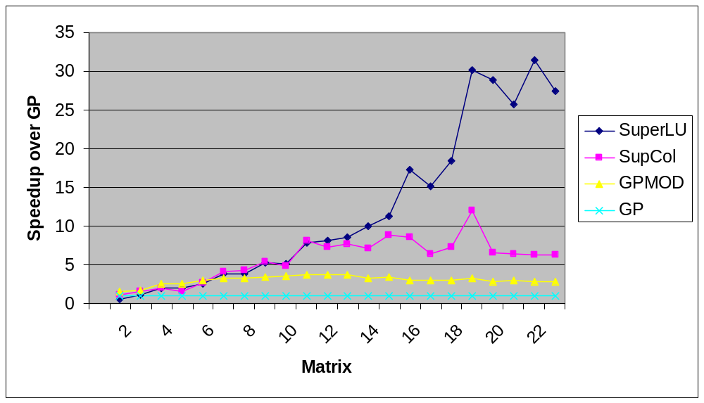
SuperLU: Relative Performance
Speedup over GP column-column
22 matrices: Order 765 to 76480; GP factor time 0.4 sec to 1.7 hr
SGI R8000 (1995)

Slide 28
Shared Memory SuperLU-MT [Demmel, G, Li]
1D data layout across processors
Dynamic assignment of panel tasks to processors
Task tree follows column elimination tree
Two sources of parallelism:
  Independent subtrees
  Pipelining dependent panel tasks
Single processor “BLAS 2.5” SuperLU kernel
Good speedup for 8-16 processors
Scalability limited by 1D data layout

Slide 29
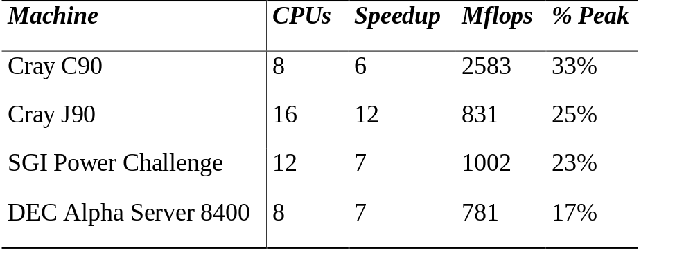
SuperLU-MT Performance Highlight (1999)
3-D flow calculation (matrix EX11, order 16614):

Slide 30
Outline
Introduction:
  A modular approach to left-looking LU
Combinatorial tools:
  Directed graphs (expose path structure)
  Column intersection graph (exploit symmetric theory)
LU algorithms:
  From depth-first search to supernodes
Column ordering:
  Column approximate minimum degree
  Open questions

Slide 31
Column Preordering for Sparsity
Q
P
=
x
PAQ^{T} = LU: Q preorders columns for sparsity, P is row pivoting
Column permutation of A ⬄ Symmetric permutation of A^{T}A (or G∩(A))
Symmetric ordering: Approximate minimum degree [Amestoy, Davis, Duff]
But, forming A^{T}A is expensive (sometimes bigger than L+U).

Slide 32
Column AMD [Davis, G, Ng, Larimore, Peyton; Matlab 6]
row
col
1
1
1
2
3
4
5
1
I
A
2
2
row
2
3
3
3
4
col
A^{T}
0
4
4
5
5
5
A
aug(A)
G(aug(A))
Eliminate “row” nodes of aug(A) first
Then eliminate “col” nodes by approximate min degree
4x speed and 1/3 better ordering than Matlab-5 min degree,
2x speed of AMD on A^{T}A
Question: Better orderings based on aug(A)?

Slide 33
GE with Static Pivoting [Li, Demmel]
Target: Distributed-memory multiprocessors
Goal: No pivoting during numeric factorization
Weighted bipartite matching [Duff, Koster]
to permute A to have large elements on diagonal
Permute A symmetrically for sparsity
Factor A = LU with no pivoting, fixing up small pivots
Improve solution by iterative refinement
As stable as partial pivoting in experiments
E.g.: Quantum chemistry systems,order 700K-1.8M,
on 24-64 PEs of ASCI Blue Pacific (IBM SP)

Slide 34
Question: Preordering for GESP
Use directed graph model,
less well understood than symmetric factorization
  Symmetric: bottom-up, top-down, hybrids
  Nonsymmetric: mostly bottom-up
  Symmetric: best ordering is NP-complete, but approximation theory is based on graph partitioning (separators)
  Nonsymmetric: no approximation theory is known;
  partitioning is not the whole story
Good approximations and efficient algorithms
both remain to be discovered

Slide 35
Conclusion
Partial pivoting:
  Good algorithms + BLAS
  => good execution rates for workstations and SMPs
  Can we understand ordering better?
Static pivoting:
  More scalable, for very large problems in distributed memory
  Experimentally stable though less well grounded in theory
  Can we understand ordering better?

